Slide 1
Green Recycle: An App for Sustainable Recycling on Campus
VASILHS DOULOS
NIKOLAOS MYTHIS
GIORGOS GERAKIOS
VASILHS KOYTOYZOS

Slide 2
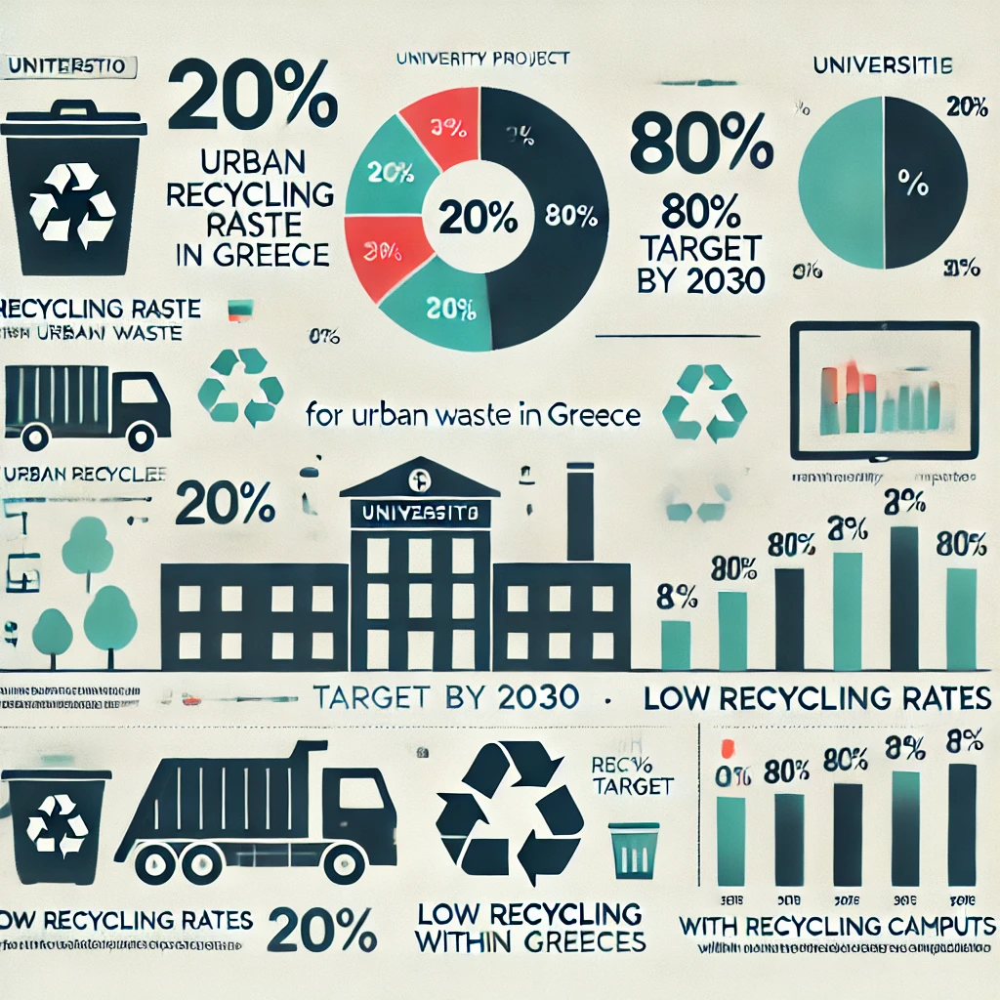
INTRODUCTION
PROBLEM: Recycling on campus is inefficient, and many students do not know how to recycle correctly

Slide 3
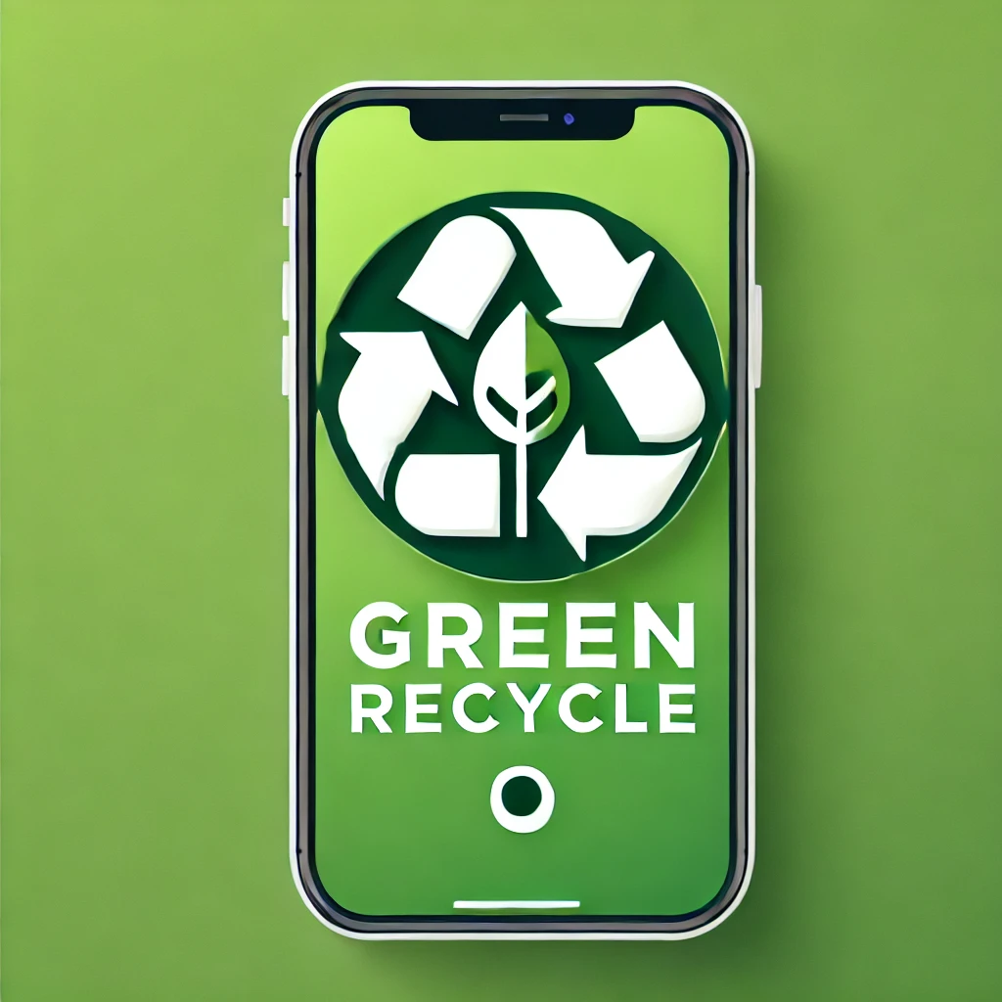
SOLUTION
Green Recycle is an app that helps students locate recycling points, learn how to recycle properly, and earn rewards for their actions
Our logo

Slide 4
Key Features
Digital Recycling Map
Recycling Guide with barcode scanning
Reward System for recycling actions
Educational material and quizzes for awareness
(Recycling Reminders)
(Interactive Recycling Guide)
(Recycling Events & Campaigns)
(Gamified Learning)

Slide 5
How the App Works
Sign Up and Create Account: Users can register on the app either via email or by using their social networks (Facebook, Google)
Locate Recycling Bin via Digital Map: Users open the app’s map to see where the nearest recycling bins are located
"Recycling Guide and Product Scanning (Barcode Scanning): Users can scan a product's barcode using their phone's camera
"Record Recycling and Earn Points: After recycling, users log their action on the app by clicking the 'Record Recycling' button. Users earn points for each entry, which can be redeemed for rewards or discounts

Slide 6
Data Analysis and Personal Report: The app provides reports and statistics for each user, such as the total amount of materials recycled and the environmental impact (e.g., how much CO₂ emissions were avoided)
Feedback and Bin Reports

Slide 7
Technologies We Use
Mobile App Development
Database & Cloud Services
API & Libraries
Flutter ή React Native
Android Studio
Swift (iOS)
Firebase
SQLite
Google Cloud Platform (GCP) or Amazon Web Services (AWS)
Google Maps AP
ZXing (Zebra Crossing)

Slide 8
User Interface Design
Analytics & Monitoring
Machine Learning & AI
Figma or Adobe XD
Material Design
Google Analytics
Firebase Crashlytics
TensorFlow Lite
OpenCV

Slide 9
Benefits & Impact
Reduction of waste and increase in recycling on campus
Raising student awareness about sustainability
Creating a greener campus
Incentives for more responsible behavior from students

Slide 10
Implementation Plan for the Green Recycle
Design & Research: Analysis of requirements and definition of key features
Prototype Development: Creation of frontend using Flutter or React Native, backend development with Node.js or Python, and database setup (Firebase)
Testing & Optimization: Real-world testing and functionality checks, bug fixing, and user experience improvement
Launch & Presentation: App release on App Store/Google Play

Slide 11
Conclusion
The 'Green Recycle' app offers an innovative and practical solution for promoting recycling on campus. With features such as the digital recycling map, interactive guide, and rewards system, it aims to increase participation and raise student awareness about sustainability. Its adoption will help reduce waste and strengthen the green culture at the university, supporting the Sustainable Development Goals and creating a more eco-friendly learning environment

Slide 12
Thank you for your attention. We believe that the 'Green Recycle' app has the potential to make a difference on our campus, promoting recycling and sustainability. Together, we can build a greener and more responsible future

